Slide 1
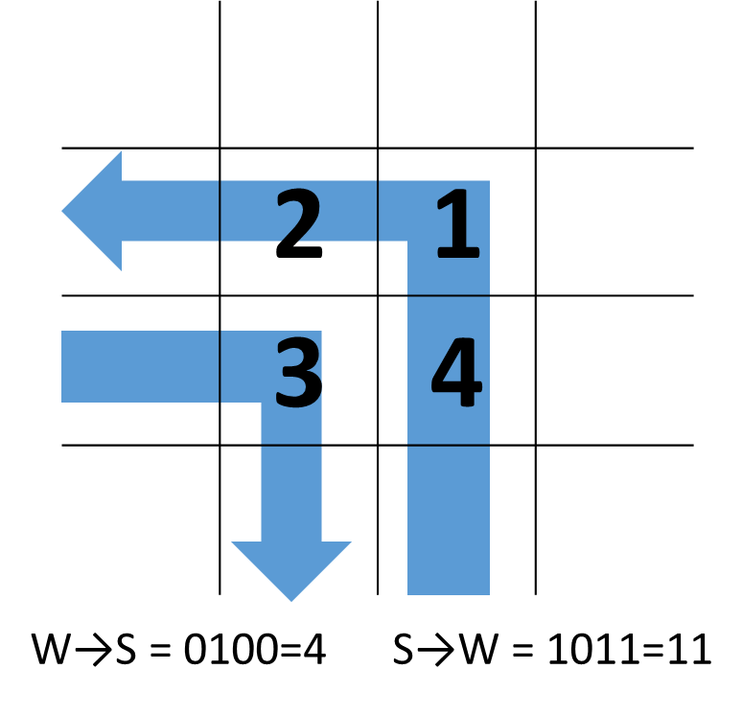
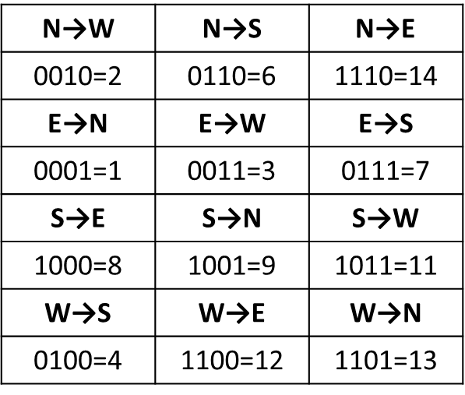
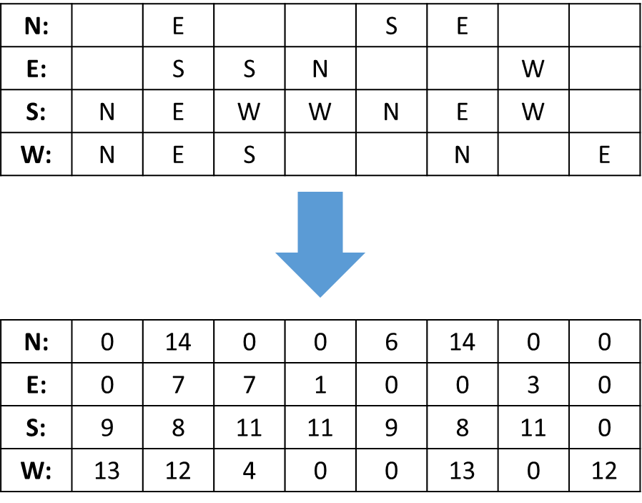
Convert the Schedule for Bitwise Operation

Slide 2
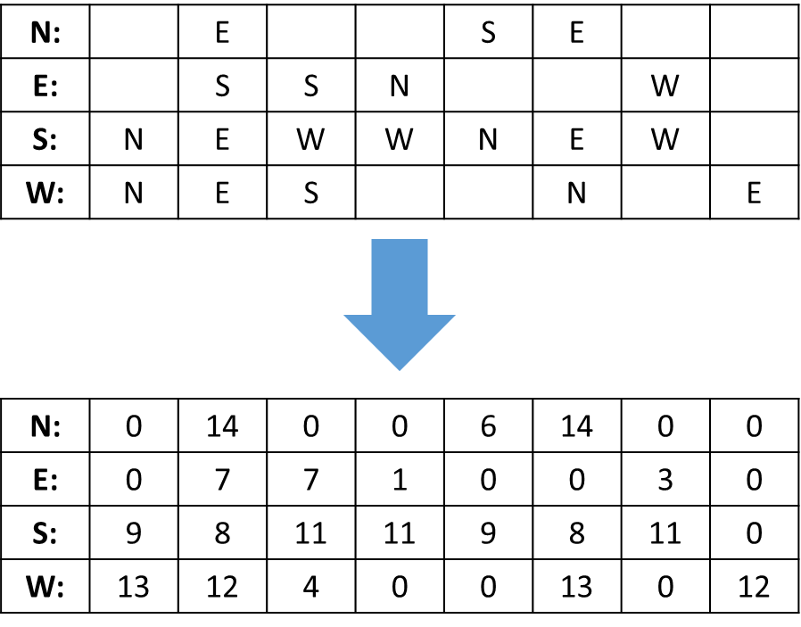
materials
N→W | N→S | N→E
0010=2 | 0110=6 | 1110=14
E→N | E→W | E→S
0001=1 | 0011=3 | 0111=7
S→E | S→N | S→W
1000=8 | 1001=9 | 1011=11
W→S | W→E | W→N
0100=4 | 1100=12 | 1101=13

Slide 3
materials
 | 2 | 1
 | 3 | 4
 | 2 | 1
 | 3 | 4
N→S = 0110=6
W→S = 0100=4
S→W = 1011=11

Slide 4
Input 2

Slide 5
 | 234 |  |  | 23 | 234
 | 123 | 123 | 1 |  |  | 12
14 | 4 | 124 | 124 | 14 | 4 | 124
134 | 34 | 3 |  |  | 134 |  | 34

Slide 6
134
v
 | 234 |  |  | 23 | 234
 | 123 | 123 | 1 |  |  | 12
14 | 4 | 124 | 124 | 14 | 4 | 124
 | 34 | 3 |  |  | 134 |  | 34

Slide 7
 | 14
134
v
 | 234 |  |  | 23 | 234
 | 123 | 123 | 1 |  |  | 12
 | 4 | 124 | 124 | 14 | 4 | 124
 | 34 | 3 |  |  | 134 |  | 34

Slide 8
 |  | 123
 | 14 | 4
134
v
 | 234 |  |  | 23 | 234
 |  | 123 | 1 |  |  | 12
 |  | 124 | 124 | 14 | 4 | 124
 | 34 | 3 |  |  | 134 |  | 34

Slide 9
 |  |  | 234
 |  | 123
 | 14 | 4
134
v
 |  |  |  | 23 | 234
 |  | 123 | 1 |  |  | 12
 |  | 124 | 124 | 14 | 4 | 124
 | 34 | 3 |  |  | 134 |  | 34

Slide 10
 |  |  | 234
 |  | 123
 | 14 | 4
134 |  |  |  | 34
v
 |  |  |  | 23 | 234
 |  | 123 | 1 |  |  | 12
 |  | 124 | 124 | 14 | 4 | 124
 |  | 3 |  |  | 134 |  | 34

Slide 11
 |  |  | 234
 |  | 123
 | 14 | 4 |  |  | 124
134 |  |  |  | 34 | 3
v
 |  |  |  | 23 | 234
 |  | 123 | 1 |  |  | 12
 |  |  | 124 | 14 | 4 | 124
 |  |  |  |  | 134 |  | 34

Slide 12
 |  |  | 234
 |  | 123 |  |  |  | 123
 | 14 | 4 |  |  | 124
134 |  |  |  | 34 | 3
v
 |  |  |  | 23 | 234
 |  |  | 1 |  |  | 12
 |  |  | 124 | 14 | 4 | 124
 |  |  |  |  | 134 |  | 34

Slide 13
 |  |  | 234 |  |  |  | 23
 |  | 123 |  |  |  | 123 | 1
 | 14 | 4 |  |  | 124
134 |  |  |  | 34 | 3
v
 |  |  |  |  | 234
 |  |  |  |  |  | 12
 |  |  | 124 | 14 | 4 | 124
 |  |  |  |  | 134 |  | 34

Slide 14
 |  |  | 234 |  |  |  | 23
 |  | 123 |  |  |  | 123 | 1
 | 14 | 4 |  |  | 124 |  |  | 124
134 |  |  |  | 34 | 3
 |  |  |  |  | 234
 |  |  |  |  |  | 12
 |  |  |  | 14 | 4 | 124
 |  |  |  |  | 134 |  | 34

Slide 15
 |  |  | 234 |  |  |  | 23
 |  | 123 |  |  |  | 123 | 1
 | 14 | 4 |  |  | 124 |  |  | 124 | 14
134 |  |  |  | 34 | 3
 |  |  |  |  | 234
 |  |  |  |  |  | 12
 |  |  |  |  | 4 | 124
 |  |  |  |  | 134 |  | 34

Slide 16
 |  |  | 234 |  |  |  | 23
 |  | 123 |  |  |  | 123 | 1 |  |  | 12
 | 14 | 4 |  |  | 124 |  |  | 124 | 14 | 4
134 |  |  |  | 34 | 3
 |  |  |  |  | 234
 |  |  |  |  |  | 124
 |  |  |  |  | 134 |  | 34

Slide 17
 |  |  | 234 |  |  |  | 23 |  |  |  | 234
 |  | 123 |  |  |  | 123 | 1 |  |  | 12
 | 14 | 4 |  |  | 124 |  |  | 124 | 14 | 4 |  |  | 124
134 |  |  |  | 34 | 3 |  |  |  |  |  |  | 134 |  | 34
 |  |  |  |  | 234
 |  |  |  |  |  | 124
 |  |  |  |  | 134 |  | 34

Slide 18
2nd step
 |  |  | 234 |  |  |  | 23 |  |  |  | 234
 |  | 123 |  |  |  | 123 | 1 |  |  | 12
 | 14 | 4 |  |  | 124 |  |  | 124 | 14 | 4 |  |  | 124
134 |  |  |  | 34 | 3 |  |  |  |  |  |  | 134 |  | 34
 | 234 |  |  | 23 | 234
 | 123 | 123 | 1 |  |  | 12
14 | 4 | 124 | 124 | 14 | 4 | 124
134 | 34 | 3 |  |  | 134 |  | 34

Slide 19
2nd step
 |  |  | 234 |  |  |  | 23 |  |  |  | 234
 | 123 |  |  |  |  | 123 | 1 |  |  | 12
14 | 4 |  |  |  | 124 |  |  | 124 | 14 | 4 |  |  | 124
 |  | 134 |  | 34 | 3 |  |  |  |  |  |  | 134 |  | 34
 | 234 |  |  | 23 | 234
 | 123 | 123 | 1 |  |  | 12
14 | 4 | 124 | 124 | 14 | 4 | 124
134 | 34 | 3 |  |  | 134 |  | 34

Slide 20
2nd step
 |  |  |  |  | 234 |  | 23 |  |  |  | 234
 | 123 |  |  |  |  | 123 | 1 |  |  | 12
14 | 4 |  |  | 124 |  |  |  | 124 | 14 | 4 |  |  | 124
 |  | 134 | 34 | 3 |  |  |  |  |  |  |  | 134 |  | 34
 | 234 |  |  | 23 | 234
 | 123 | 123 | 1 |  |  | 12
14 | 4 | 124 | 124 | 14 | 4 | 124
134 | 34 | 3 |  |  | 134 |  | 34

Slide 21
Answer
 |  |  |  |  | 234 |  | 23 |  | 234
 | 123 |  |  |  |  |  |  | 123 | 1 |  | 12
14 | 4 |  |  | 124 |  | 124 | 14 | 4 |  |  |  | 124
 |  | 134 | 34 | 3 |  |  |  |  |  | 134 | 34
 | 234 |  |  | 23 | 234
 | 123 | 123 | 1 |  |  | 12
14 | 4 | 124 | 124 | 14 | 4 | 124
134 | 34 | 3 |  |  | 134 |  | 34

Slide 22
Input 3

Slide 23
234 |  | 234 |  | 23 | 234
 | 123 | 123 | 123 | 1 |  | 12
4 | 4 | 4 | 4 |  | 4 | 124
34 | 34 |  |  | 34 | 134 |  | 34

Slide 24
234
v
 |  | 234 |  | 23 | 234
 | 123 | 123 | 123 | 1 |  | 12
4 | 4 | 4 | 4 |  | 4 | 124
34 | 34 |  |  | 34 | 134 |  | 34

Slide 25
234
 | 123
 | 4
v
 |  | 234 |  | 23 | 234
 |  | 123 | 123 | 1 |  | 12
 | 4 | 4 | 4 |  | 4 | 124
34 | 34 |  |  | 34 | 134 |  | 34

Slide 26
234
 | 123 | 123
 | 4 | 4
v
 |  | 234 |  | 23 | 234
 |  |  | 123 | 1 |  | 12
 |  | 4 | 4 |  | 4 | 124
34 | 34 |  |  | 34 | 134 |  | 34

Slide 27
234
 | 123 | 123 | 123
 | 4 | 4 | 4
v
 |  | 234 |  | 23 | 234
 |  |  |  | 1 |  | 12
 |  |  | 4 |  | 4 | 124
34 | 34 |  |  | 34 | 134 |  | 34

Slide 28
234 |  |  |  | 234
 | 123 | 123 | 123 | 1
 | 4 | 4 | 4
v
 |  |  |  | 23 | 234
 |  |  |  |  |  | 12
 |  |  | 4 |  | 4 | 124
34 | 34 |  |  | 34 | 134 |  | 34

Slide 29
234 |  |  |  | 234 | 23
 | 123 | 123 | 123 | 1
 | 4 | 4 | 4 |  | 4
v
 |  |  |  |  | 234
 |  |  |  |  |  | 12
 |  |  |  |  | 4 | 124
34 | 34 |  |  | 34 | 134 |  | 34

Slide 30
234 |  |  |  | 234 | 23
 | 123 | 123 | 123 | 1 |  | 12
 | 4 | 4 | 4 |  | 4
 |  |  |  |  |  | 34
v
 |  |  |  |  | 234
 |  |  |  |  | 4 | 124
 | 34 |  |  | 34 | 134 |  | 34

Slide 31
234 |  |  |  | 234 | 23
 | 123 | 123 | 123 | 1 |  | 12
 | 4 | 4 | 4 |  | 4
 |  |  |  |  |  | 34 | 34
v
 |  |  |  |  | 234
 |  |  |  |  | 4 | 124
 |  |  |  | 34 | 134 |  | 34

Slide 32
234 |  |  |  | 234 | 23
 | 123 | 123 | 123 | 1 |  | 12
 | 4 | 4 | 4 |  | 4
 |  |  |  |  |  | 34 | 34 | 34
v
 |  |  |  |  | 234
 |  |  |  |  | 4 | 124
 |  |  |  |  | 134 |  | 34

Slide 33
234 |  |  |  | 234 | 23 |  |  |  | 234
 | 123 | 123 | 123 | 1 |  | 12
 | 4 | 4 | 4 |  | 4 |  |  |  |  |  | 4 | 124
 |  |  |  |  |  | 34 | 34 | 34 |  | 134 |  |  | 34
 |  |  |  |  | 234
 |  |  |  |  | 4 | 124
 |  |  |  |  | 134 |  | 34

Slide 34
Answer
234 |  |  |  | 234 | 23 |  |  |  |  | 234
 | 123 | 123 | 123 | 1 |  | 12
 | 4 | 4 | 4 |  | 4 |  |  |  | 4 |  |  | 124
 |  |  |  |  |  | 34 | 34 | 34 |  |  | 134 |  | 34
234 |  | 234 |  | 23 | 234
 | 123 | 123 | 123 | 1 |  | 12
4 | 4 | 4 | 4 |  | 4 | 124
34 | 34 |  |  | 34 | 134 |  | 34

Slide 35
Input 4

Slide 36
v
 | 234 |  |  | 234
 |  |  | 123 |  | 1 | 123
4 | 124 | 124 | 124 | 14 |  | 14 | 4
134 |  | 134 |  |  | 134 |  | 34

Slide 37
134
v
 | 234 |  |  | 234
 |  |  | 123 |  | 1 | 123
4 | 124 | 124 | 124 | 14 |  | 14 | 4
 |  | 134 |  |  | 134 |  | 34

Slide 38
 | 4
134
v
 | 234 |  |  | 234
 |  |  | 123 |  | 1 | 123
 | 124 | 124 | 124 | 14 |  | 14 | 4
 |  | 134 |  |  | 134 |  | 34

Slide 39
 |  | 234
 | 4
134
v
 |  |  |  | 234
 |  |  | 123 |  | 1 | 123
 | 124 | 124 | 124 | 14 |  | 14 | 4
 |  | 134 |  |  | 134 |  | 34

Slide 40
 |  | 234
 | 4 |  | 124
134
v
 |  |  |  | 234
 |  |  | 123 |  | 1 | 123
 |  | 124 | 124 | 14 |  | 14 | 4
 |  | 134 |  |  | 134 |  | 34

Slide 41
 |  | 234
 | 4 |  | 124
134 |  |  |  | 134
v
 |  |  |  | 234
 |  |  | 123 |  | 1 | 123
 |  | 124 | 124 | 14 |  | 14 | 4
 |  |  |  |  | 134 |  | 34

Slide 42
 |  | 234
 | 4 |  | 124 |  | 124
134 |  |  |  | 134
v
 |  |  |  | 234
 |  |  | 123 |  | 1 | 123
 |  |  | 124 | 14 |  | 14 | 4
 |  |  |  |  | 134 |  | 34

Slide 43
 |  | 234
 |  |  |  |  |  | 123
 | 4 |  | 124 |  | 124
134 |  |  |  | 134
v
 |  |  |  | 234
 |  |  |  |  | 1 | 123
 |  |  | 124 | 14 |  | 14 | 4
 |  |  |  |  | 134 |  | 34

Slide 44
 |  | 234 |  |  |  |  | 234
 |  |  |  |  |  | 123 | 1
 | 4 |  | 124 |  | 124
134 |  |  |  | 134
v
 |  |  |  |  |  | 123
 |  |  | 124 | 14 |  | 14 | 4
 |  |  |  |  | 134 |  | 34

Slide 45
 |  | 234 |  |  |  |  | 234
 |  |  |  |  |  | 123 | 1
 | 4 |  | 124 |  | 124 |  |  | 124
134 |  |  |  | 134
v
 |  |  |  |  |  | 123
 |  |  |  | 14 |  | 14 | 4
 |  |  |  |  | 134 |  | 34

Slide 46
 |  | 234 |  |  |  |  | 234
 |  |  |  |  |  | 123 | 1
 | 4 |  | 124 |  | 124 |  |  | 124 | 14
134 |  |  |  | 134
v
 |  |  |  |  |  | 123
 |  |  |  |  |  | 14 | 4
 |  |  |  |  | 134 |  | 34

Slide 47
 |  | 234 |  |  |  |  | 234
 |  |  |  |  |  | 123 | 1
 | 4 |  | 124 |  | 124 |  |  | 124 | 14
134 |  |  |  | 134 |  |  |  |  |  | 134
v
 |  |  |  |  |  | 123
 |  |  |  |  |  | 14 | 4
 |  |  |  |  |  |  | 34

Slide 48
 |  | 234 |  |  |  |  | 234
 |  |  |  |  |  | 123 | 1 |  |  |  | 123
 | 4 |  | 124 |  | 124 |  |  | 124 | 14
134 |  |  |  | 134 |  |  |  |  |  | 134
v
 |  |  |  |  |  | 14 | 4
 |  |  |  |  |  |  | 34

Slide 49
 |  | 234 |  |  |  |  | 234
 |  |  |  |  |  | 123 | 1 |  |  |  | 123
 | 4 |  | 124 |  | 124 |  |  | 124 | 14 |  |  | 14
134 |  |  |  | 134 |  |  |  |  |  | 134
v
 |  |  |  |  |  |  | 4
 |  |  |  |  |  |  | 34

Slide 50
 |  | 234 |  |  |  |  | 234
 |  |  |  |  |  | 123 | 1 |  |  |  | 123
 | 4 |  | 124 |  | 124 |  |  | 124 | 14 |  |  | 14
134 |  |  |  | 134 |  |  |  |  |  | 134 |  |  | 34

Slide 51
 |  | 234 |  |  |  |  | 234
 |  |  |  |  |  | 123 | 1 |  |  |  | 123
 | 4 |  | 124 |  | 124 |  |  | 124 | 14 |  |  | 14 |  | 4
134 |  |  |  | 134 |  |  |  |  |  | 134 |  |  | 34
v

Slide 52
Answer
 | 234 |  |  |  | 234
 |  |  | 123 |  | 1 |  |  |  |  |  | 123
 |  |  | 4 | 124 |  | 124 | 124 | 14 |  | 14 | 4
134 |  | 134 |  |  |  |  |  |  | 134 |  |  | 34
 | 234 |  |  | 234
 |  |  | 123 |  | 1 | 123
4 | 124 | 124 | 124 | 14 |  | 14 | 4
134 |  | 134 |  |  | 134 |  | 34

Slide 53
 |  | 234 |  |  |  | 234
 |  |  |  |  | 123 | 1 |  |  |  |  |  | 123
 | 4 |  | 124 |  |  |  | 124 | 124 | 14 |  | 14 | 4
134 |  |  |  | 134 |  |  |  |  |  | 134 |  |  | 34
Answer
 | 234 |  |  |  | 234
 |  |  | 123 |  | 1 |  |  |  |  |  | 123
 |  |  | 4 | 124 |  | 124 | 124 | 14 |  | 14 | 4
134 |  | 134 |  |  |  |  |  |  | 134 |  |  | 34
 | 234 |  |  | 234
 |  |  | 123 |  | 1 | 123
4 | 124 | 124 | 124 | 14 |  | 14 | 4
134 |  | 134 |  |  | 134 |  | 34

Slide 54
Input 5

Slide 55
v
234 | 2 | 234 | 23 | 234
123 | 123 | 12 | 1 | 12
14 | 4 | 4 | 124 | 14
34 | 134 | 3 | 34 | 134

Slide 56
123
v
234 | 2 | 234 | 23 | 234
 | 123 | 12 | 1 | 12
14 | 4 | 4 | 124 | 14
34 | 134 | 3 | 34 | 134

Slide 57
 | 234
123
v
 | 2 | 234 | 23 | 234
 | 123 | 12 | 1 | 12
14 | 4 | 4 | 124 | 14
34 | 134 | 3 | 34 | 134

Slide 58
 | 234 | 2
123
 |  | 34
v
 |  | 234 | 23 | 234
 | 123 | 12 | 1 | 12
14 | 4 | 4 | 124 | 14
 | 134 | 3 | 34 | 134

Slide 59
 | 234 | 2
123
 |  |  | 14
 |  | 34
v
 |  | 234 | 23 | 234
 | 123 | 12 | 1 | 12
 | 4 | 4 | 124 | 14
 | 134 | 3 | 34 | 134

Slide 60
 | 234 | 2
123 |  |  |  | 123
 |  |  | 14 | 4
 |  | 34
v
 |  | 234 | 23 | 234
 |  | 12 | 1 | 12
 |  | 4 | 124 | 14
 | 134 | 3 | 34 | 134

Slide 61
 | 234 | 2
123 |  |  |  | 123 | 12
 |  |  | 14 | 4 | 4
 |  | 34
 |  | 234 | 23 | 234
 |  |  | 1 | 12
 |  |  | 124 | 14
 | 134 | 3 | 34 | 134

Slide 62
 | 234 | 2 |  |  |  | 234
123 |  |  |  | 123 | 12 | 1
 |  |  | 14 | 4 | 4
 |  | 34
 |  |  | 23 | 234
 |  |  |  | 12
 |  |  | 124 | 14
 | 134 | 3 | 34 | 134

Slide 63
 | 234 | 2 |  |  |  | 234
123 |  |  |  | 123 | 12 | 1
 |  |  | 14 | 4 | 4
 |  | 34 |  |  |  |  | 134
 |  |  | 23 | 234
 |  |  |  | 12
 |  |  | 124 | 14
 |  | 3 | 34 | 134

Slide 64
 | 234 | 2 |  |  |  | 234
123 |  |  |  | 123 | 12 | 1
 |  |  | 14 | 4 | 4 |  |  | 124
 |  | 34 |  |  |  |  | 134 | 3
 |  |  | 23 | 234
 |  |  |  | 12
 |  |  |  | 14
 |  |  | 34 | 134

Slide 65
 | 234 | 2 |  |  |  | 234 |  |  | 23
123 |  |  |  | 123 | 12 | 1 |  |  |  | 12
 |  |  | 14 | 4 | 4 |  |  | 124 | 14
 |  | 34 |  |  |  |  | 134 | 3 |  | 34
 |  |  |  | 234
 |  |  |  | 134

Slide 66
Feasible done
 | 234 | 2 |  |  |  | 234 |  |  | 23 |  | 234
123 |  |  |  | 123 | 12 | 1 |  |  |  | 12
 |  |  | 14 | 4 | 4 |  |  | 124 | 14
 |  | 34 |  |  |  |  | 134 | 3 |  | 34 |  | 134

Slide 67
Opt start
 | 234 | 2 |  |  |  | 234 |  |  | 23 |  | 234
123 |  |  |  | 123 | 12 | 1 |  |  |  | 12
 |  |  | 14 | 4 | 4 |  |  | 124 | 14
 |  | 34 |  |  |  |  | 134 | 3 |  | 34 |  | 134
234 | 2 | 234 | 23 | 234
123 | 123 | 12 | 1 | 12
14 | 4 | 4 | 124 | 14
34 | 134 | 3 | 34 | 134

Slide 68
234 | 2 |  |  |  |  | 234 |  |  | 23 |  | 234
 |  | 123 |  | 123 | 12 | 1 |  |  |  | 12
 |  |  | 14 | 4 | 4 |  |  | 124 | 14
 | 34 |  |  |  |  |  | 134 | 3 |  | 34 |  | 134
234 | 2 | 234 | 23 | 234
123 | 123 | 12 | 1 | 12
14 | 4 | 4 | 124 | 14
34 | 134 | 3 | 34 | 134

Slide 69
Result (find by eyes) (3.25)
234 | 2 |  |  |  | 234 |  |  |  | 23 | 234
 |  | 123 | 123 | 12 | 1 |  |  | 12
 | 14 | 4 | 4 |  |  |  | 124 |  | 14
 |  |  |  | 34 |  | 134 | 3 | 34 |  |  | 134
234 | 2 | 234 | 23 | 234
123 | 123 | 12 | 1 | 12
14 | 4 | 4 | 124 | 14
34 | 134 | 3 | 34 | 134

Slide 70
Result: find by program (3.15)
 |  |  |  | 234 | 2 |  |  | 234 | 23 | 234
 | 123 | 123 | 12 | 1 |  |  | 12
14 | 4 | 4 |  |  |  | 124 |  |  | 14
 |  |  | 34 |  | 134 | 3 | 34 |  |  |  | 134
234 | 2 | 234 | 23 | 234
123 | 123 | 12 | 1 | 12
14 | 4 | 4 | 124 | 14
34 | 134 | 3 | 34 | 134

